Slide 1
Capstone Engagement
Assessment, Analysis, and Hardening of a Vulnerable System
By: Tristen Maetzold

Slide 2
Table of Contents
This document contains the following sections:
01
Network Topology
02
Red Team: Security Assessment
03
Blue Team: Log Analysis and Attack Characterization
Hardening: Proposed Alarms and Mitigation Strategies
04

Slide 3
Network Topology
‹#›

Slide 4
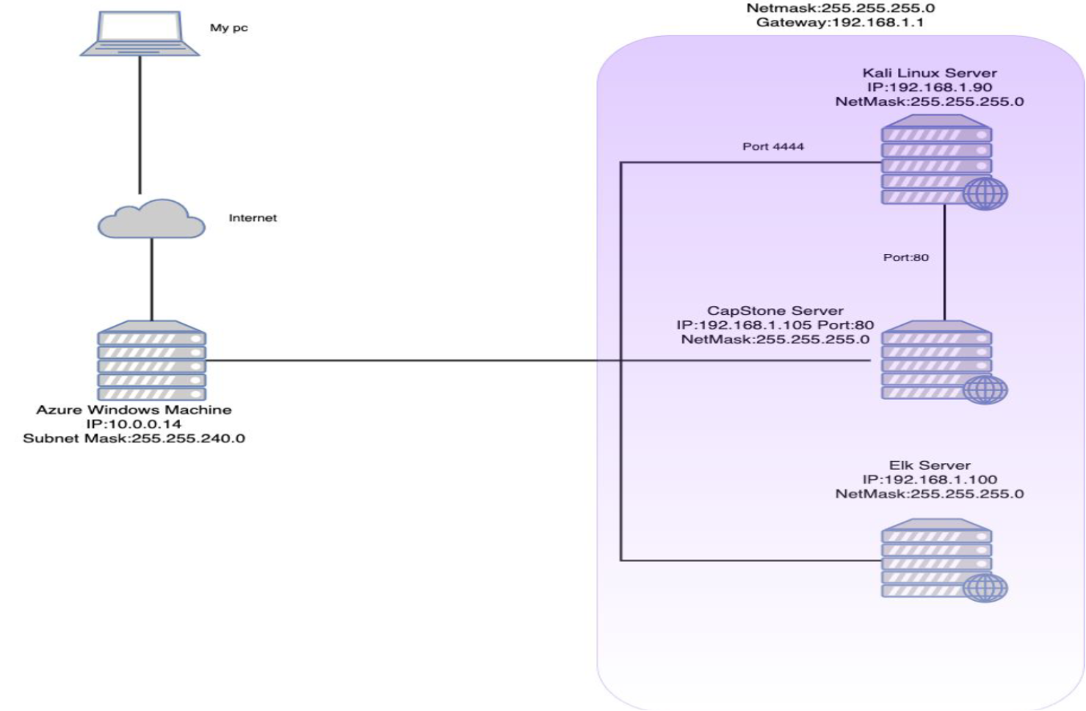
Network Topology
[Insert Here]
Use draw.io to create a diagram of the network.
Add your diagram to this slide and fill out the data in the sidebar.
Network
Address Range: 192.168.1.0/24
Netmask: 255.255.255.0
Gateway: 192.168.1.1
Machines
IPv4: 192.167.1.90
OS: Linux
Hostname: Kali
IPv4: 192.168.1.105
OS: Linux
Hostname: Capstone
IPv4: 192.168.1.100
OS: Linux
Hostname: ELK
IPv4: 192.168.1.1
OS: Windows
Hostname: ML-RFVM-68 4424 Azure

Slide 5

Red Team
Security Assessment
‹#›

Slide 6
Recon: Describing the Target
Nmap identified the following hosts on the network:
Hostname | IP Address | Role on Network
Kali | 192.168.1.90 | Attacking Machine
Capstone | 192.168.1.105 | Defending Machine
ELK | 192.168.1.100 | Network Monitor (Kibana)
Hyper V Manager | 192.168.1.1 | Virtual Machine Host

Slide 7
Vulnerability Assessment
The assessment uncovered the following critical vulnerabilities in the target:
Vulnerability | Description | Impact
CWE-200: Exposure of Sensitive Information to an Unauthorized Actor (1I) | Information is disclosed that the recipient is not mean to receive. | Found the ‘secret_folder’
CWE-200: Exposure of Sensitive Information to an Unauthorized Actor (II) | Information is disclosed that the recipient is not mean to receive. | Brute force password for ‘secret_folder’
CWE-434: Unrestricted Upload of File with Dangerous Type | Arbitrary code execution is possible if the uploaded file is interpreted and executed as code. | Allows me to upload php reverse shell to webdav share.
OWASP A02:2021 - Cryptographic Failures | Deprecated hash functions (e.g. MD5 or SHA1) are in use | Able to unhash passwords and get credentials
OWASP A05:2021 - Security Misconfiguration | Missing appropriate security hardening across any part of application stack. | SSH allows password authentication.

Slide 8
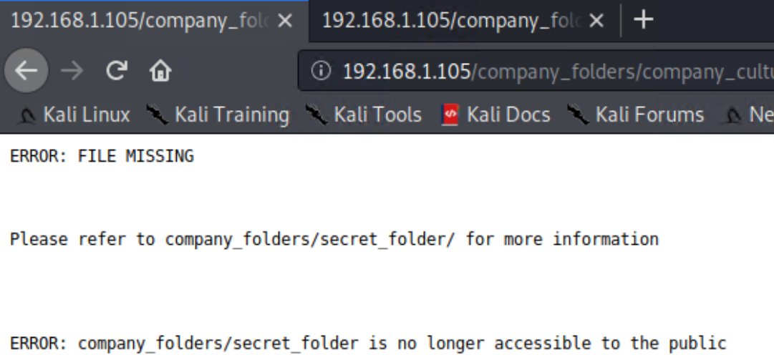
Exploitation: Learning of ‘Secret_Folder’
01
02
Tools & Processes
Sleuthing through 192.168.1.105 on a web browser.
Achievements
company_folders/secret_folder/ exists

Slide 9
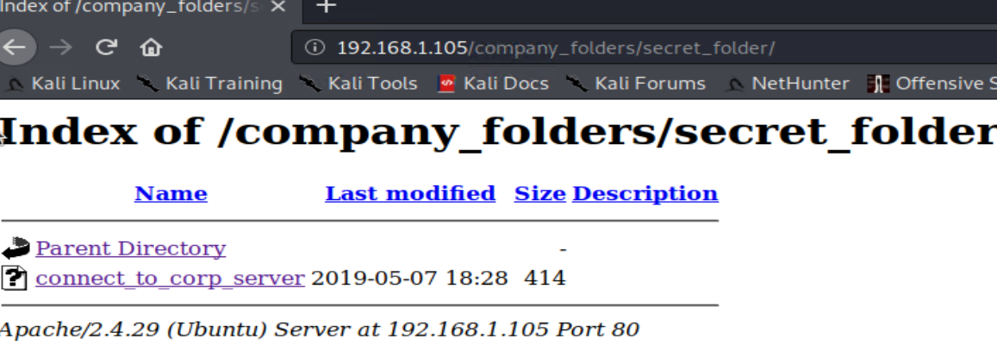
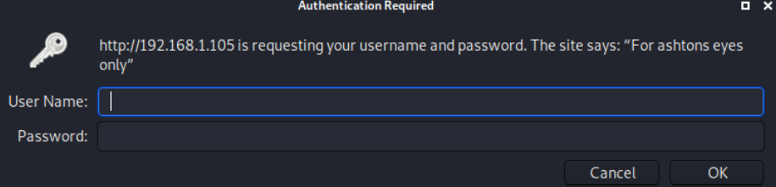
Exploitation: Hydra Brute Forcing
01
02
Tools & Processes
Use the ‘Hydra’ tool to find the password.
Achievements
Found Ashton’s credentials and signed in.

Slide 10
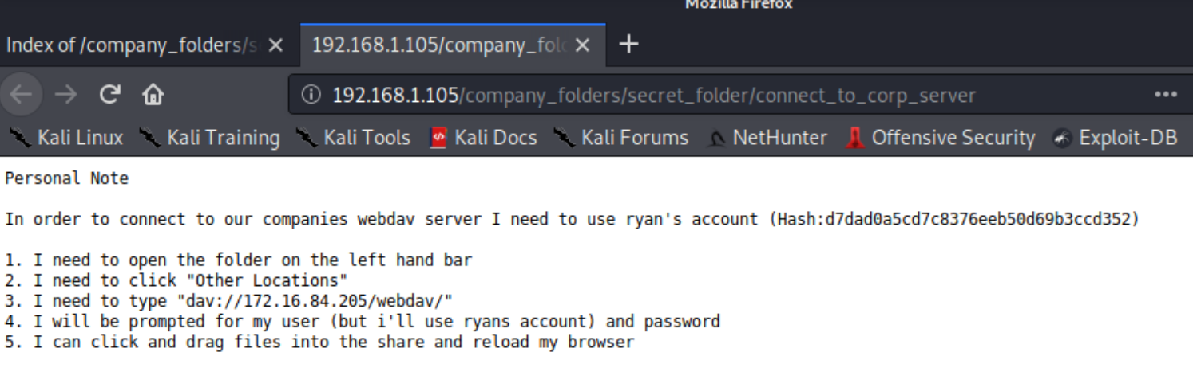
Exploitation: Instructions Located for webdav
01
02
Tools & Processes
Signed into the /secret_folder/ using credentials from Hydra.
Achievements
Retrieved webdav instructions.

Slide 11

Exploitation: Crack the Hash
01
02
Tools & Processes
Cracked the hash found in ‘secret_folder’ using a website called crackstation.net found by googling ‘Hash Cracking website’.
Achievements
Acquired Ryan’s password.

Slide 12
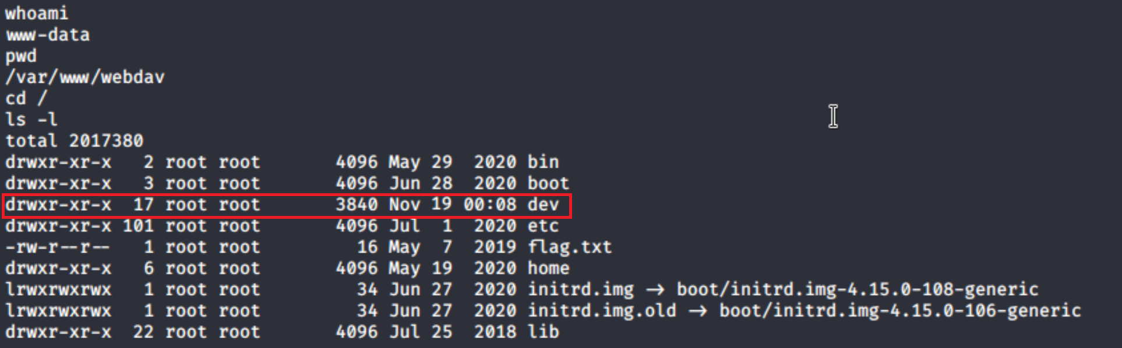
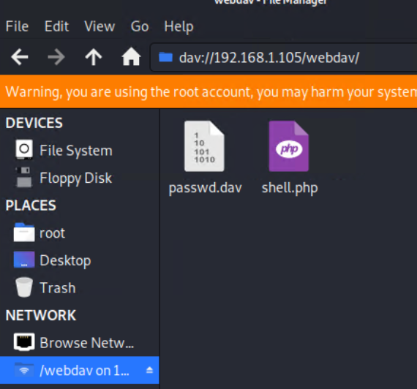
Exploitation: Reverse Shell Delivery
01
02
Tools & Processes
Utilized msfvenom to create a reverse shell, and uploaded it via webdav. This shell connects back to the Kali machine.
Achievements
I can now execute commands on the system.

Slide 13

Blue Team
Log Analysis and Attack Characterization
‹#›

Slide 14
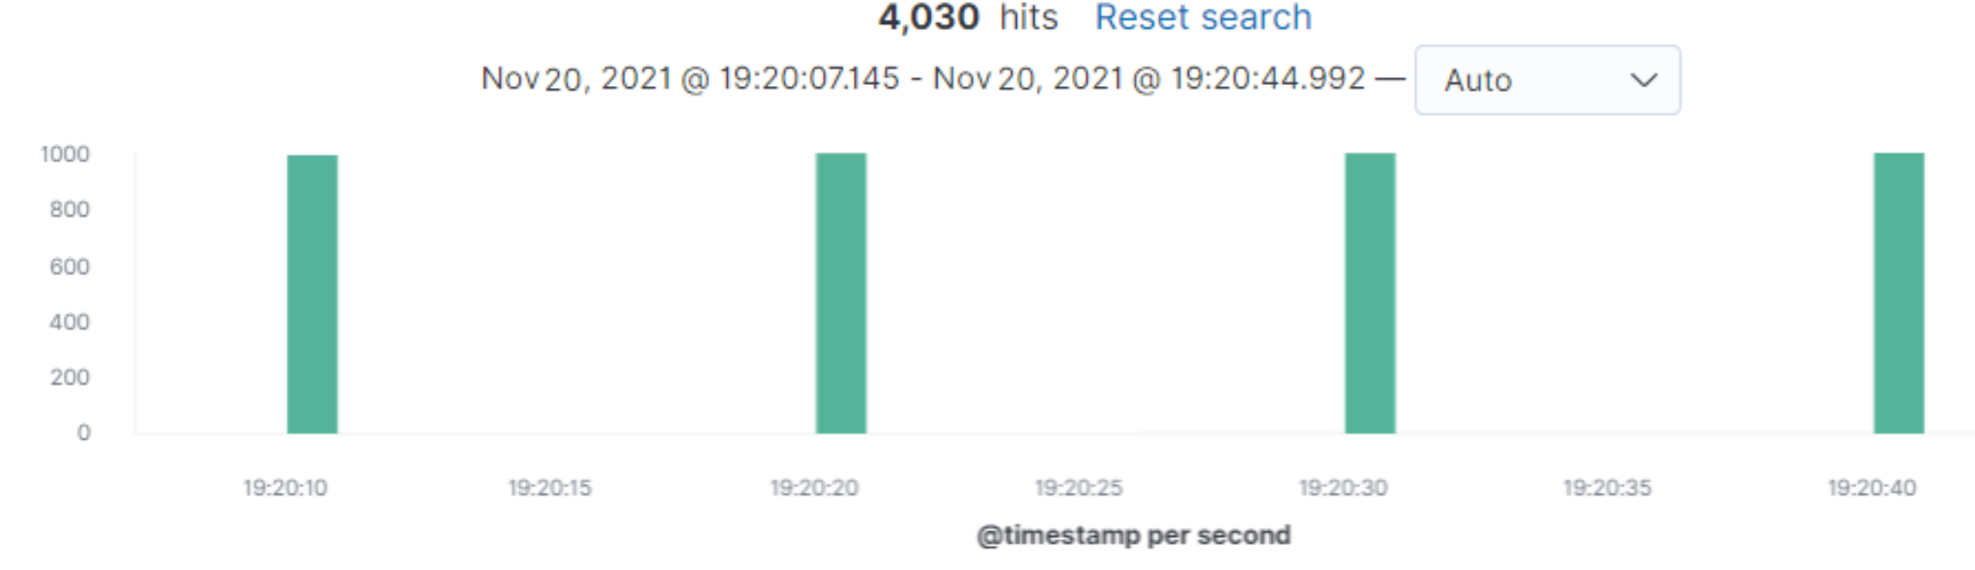
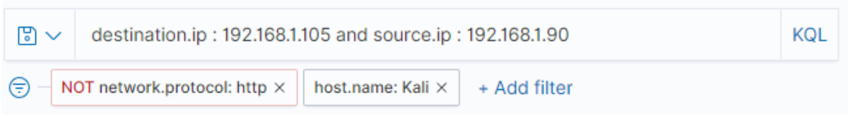
Analysis: Identifying the Port Scan
4 scans occurred between 19:20:10-19:20:40
4030 packets were sent from 192.168.1.90
Only common ports are scanned with a single packet (Syn)

Slide 15
Analysis: Finding the Request for the Hidden Directory
Two requests were made between 18:55 and 19:05
They requested secret_folder/connect_to_corp_server.
This folder contains ‘webdav’ instructions.

Slide 16
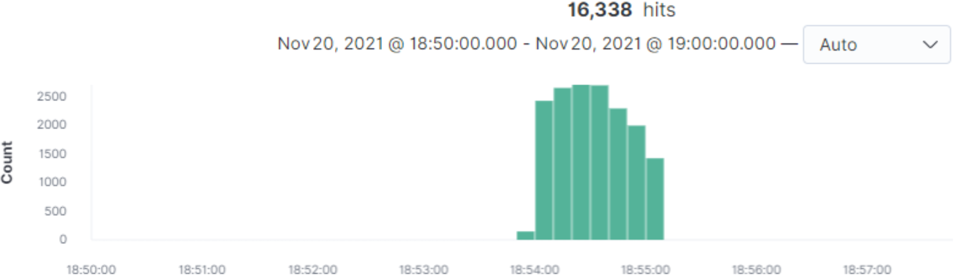
Analysis: Uncovering the Brute Force Attack
16,338 attempts before the password was discovered.

Slide 17
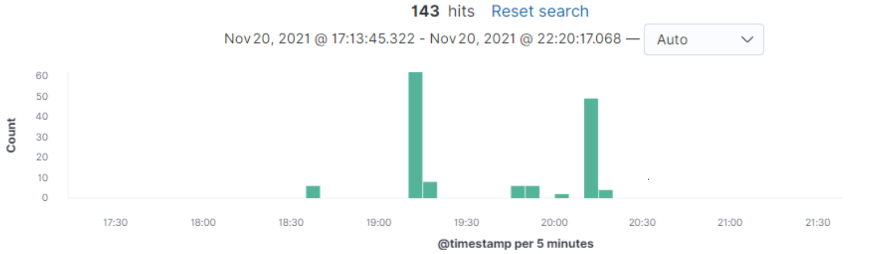
Analysis: Finding the WebDAV Connection
Directory | /webdav | /webdav/passw.dav | /webdav/shell.php | /webdavv
Requests | 95 | 34 | 13 | 1

Slide 18
Blue Team
Proposed Alarms and Mitigation Strategies
‹#›

Slide 19
Mitigation: Blocking the Port Scan
An alert that triggers when many scans occur over a short period of time
8 scans in 1 minute
Firewall rules that only allow intranet access
Differentiate between external and internal traffic

Slide 20
Mitigation: Finding the Request for the Hidden Directory
Alert if ‘secret_folder’ has connection attempts from someone not on the whitelist
The alarm should trigger immediately for sensitive data.
Apache mod_authz_host that Require ‘ip’ for file access to whitelisted OU’s.

Slide 21
Mitigation: Preventing Brute Force Attacks
Monitor the number of 401 errors occurring.
I recommend that the alarm triggers after 50 errors in 1 minute as these attacks happen rapidly .
What configuration can be set on the host to block brute force attacks?
Adding a Captcha, or any anti-bot measures.
Adding a delay to password processing to slow down the process slightly; 1-3 second delay.

Slide 22
Mitigation: Detecting the WebDAV Connection
Alert when the number of connection attempts to the webDAV exceeds a threshold
5 connection attempts a minute
Whitelist remote access IP’s

Slide 23
Mitigation: Identifying Reverse Shell Uploads
Alert triggers whenever a source attempts to upload a PHP or other executable to the server
This should trigger immediately
Deny all PHP or other executable files from being uploaded
or
Encrypt PHP or other executables on upload for examination; Lock them away so we can find more identifiers from the attacker

